Slide 1
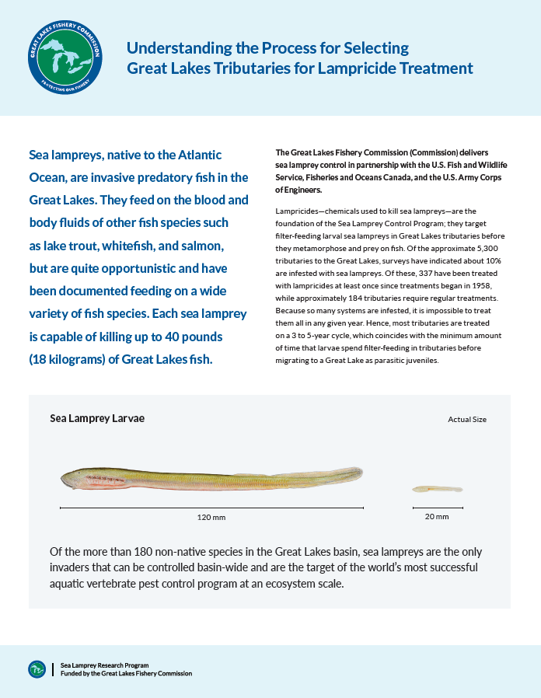

Science Transfer Project:
Understanding the Process for Selecting Great Lakes Tributaries for Lampricide Treatment

Slide 2
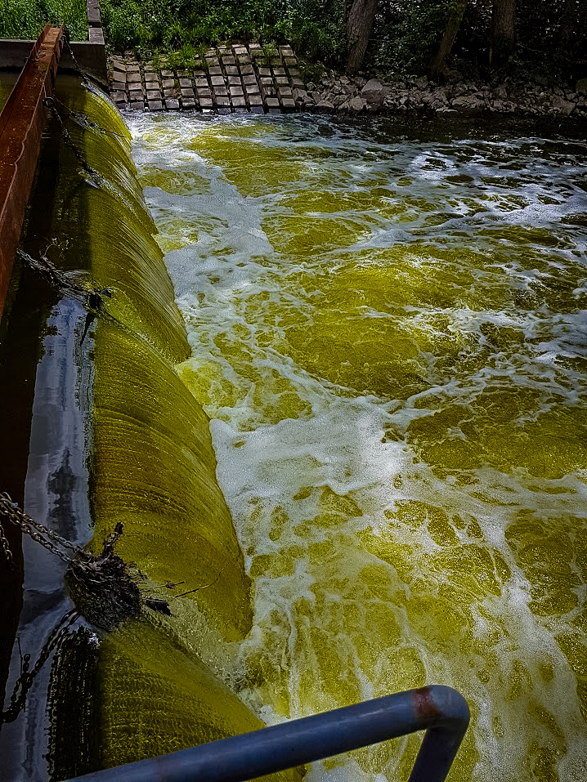
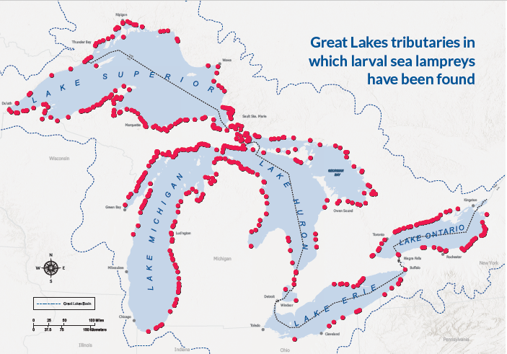
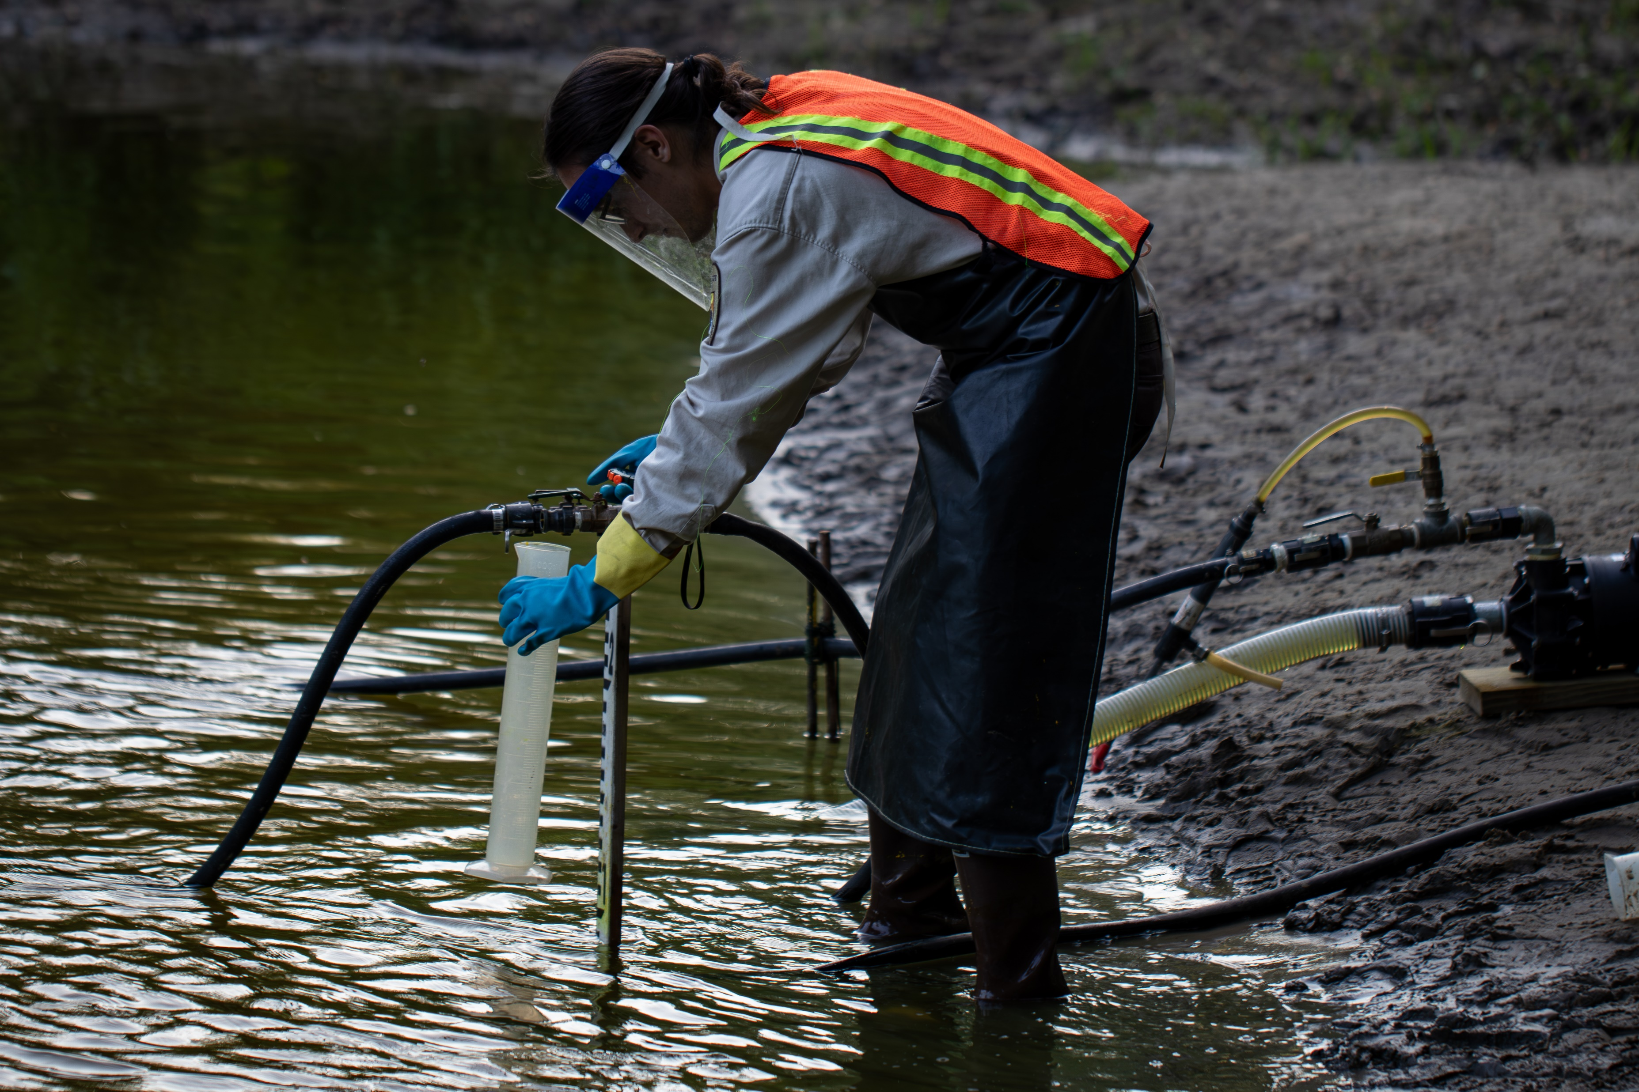
Each year, from April to October, agents for the Sea Lamprey Control Program perform lampricide treatments on approximately 120 tributaries.

Slide 3
Many factors go into making decisions about which infested Great Lakes tributaries will be treated for sea lampreys in any given year.
Density and length of larval sea lampreys
Treatment resource and staff availability
Permitting
Concurrence with state, federal, and Indigenous partners
Species at risk and culturally sensitive species
Access to treatment area
Stream discharge and water chemistry
Seasonal weather patterns and precipitation
Weekends and holidays
Migration and spawning seasons of other aquatic species

Slide 4
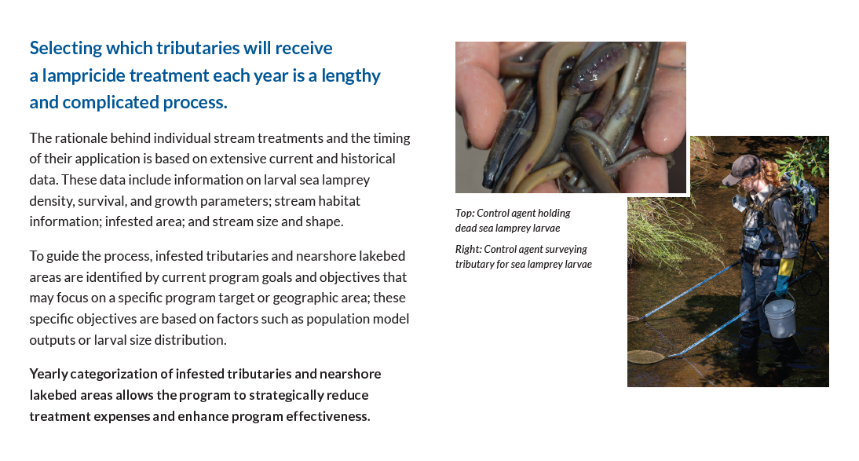
Simplifying leads to better understanding

Slide 5
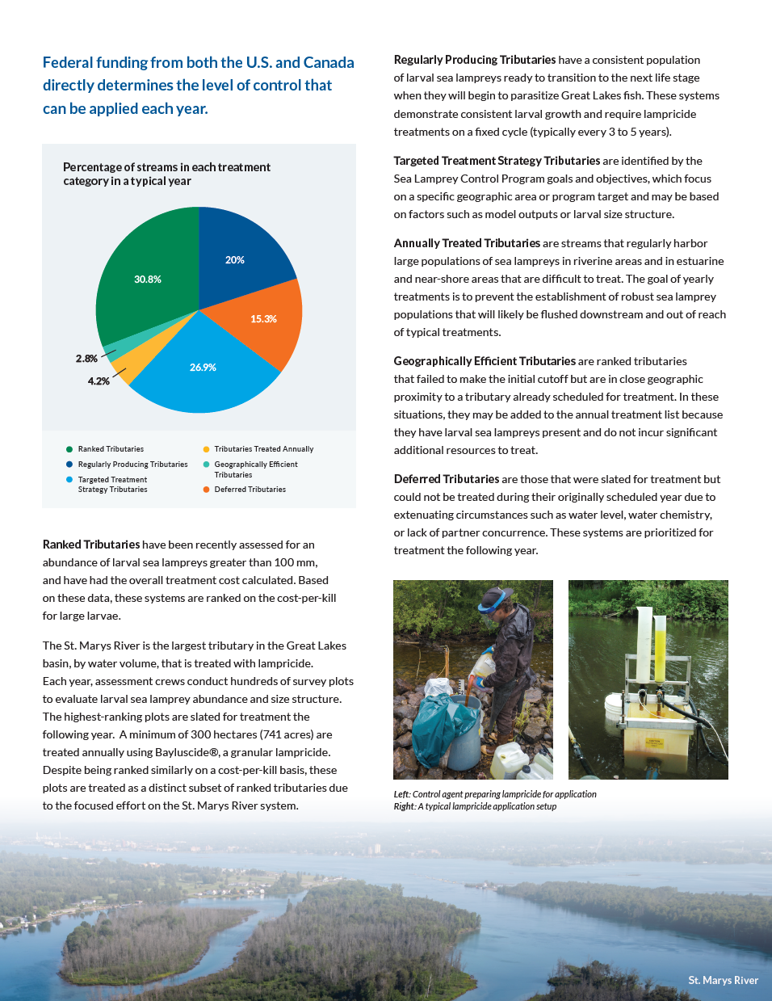
Describing the stream selection process will enable fisheries managers to communicate it more effectively to constituents.
Infested streams fall into six categories:
  Ranked
  Regularly Producing
  Targeted Treatment Strategy
  Annually Treated
  Geographically Efficient
  Deferred

Slide 6
Recently assessed for larval sea lampreys > 100mm
Have had the overall treatment cost calculated
Ranked on cost-per-kill
The St. Marys River is the largest tributary in the Great Lakes basin, by water volume, that is treated with lampricide and is treated as a distinct subset of ranked tributaries.
CATEGORY 1:
RANKED TRIBUTARIES
CATEGORY 2:
REGULARLY PRODUCING TRIBUTARIES
Consistent population of larval sea lampreys about to metamorphose
Demonstrate consistent larval growth
Require lampricide treatments on a fixed cycle

Slide 7
CATEGORY 3:
TARGETED TREATMENT STRATEGY TRIBUTARIES
Identified by SLCP goals and objectives
Focus on a specific geographic area or program target
May be based on certain factors
CATEGORY 4:
ANNUALLY TREATED TRIBUTARIES
Regularly harbor large populations of sea lampreys
Annual treatment to prevent the establishment of a robust sea lamprey population

Slide 8
CATEGORY 5:
GEOGRAPHICALLY EFFICIENT TRIBUTARIES
Failed to make the initial cutoff in ranking
Are close in geographic proximity to a scheduled tributary
Do not incur significant additional resources to treat
CATEGORY 6:
DEFERRED TRIBUTARIES
Slated for treatment
Could not treat due to extenuating circumstances
Prioritized for treatment the following year

Slide 9
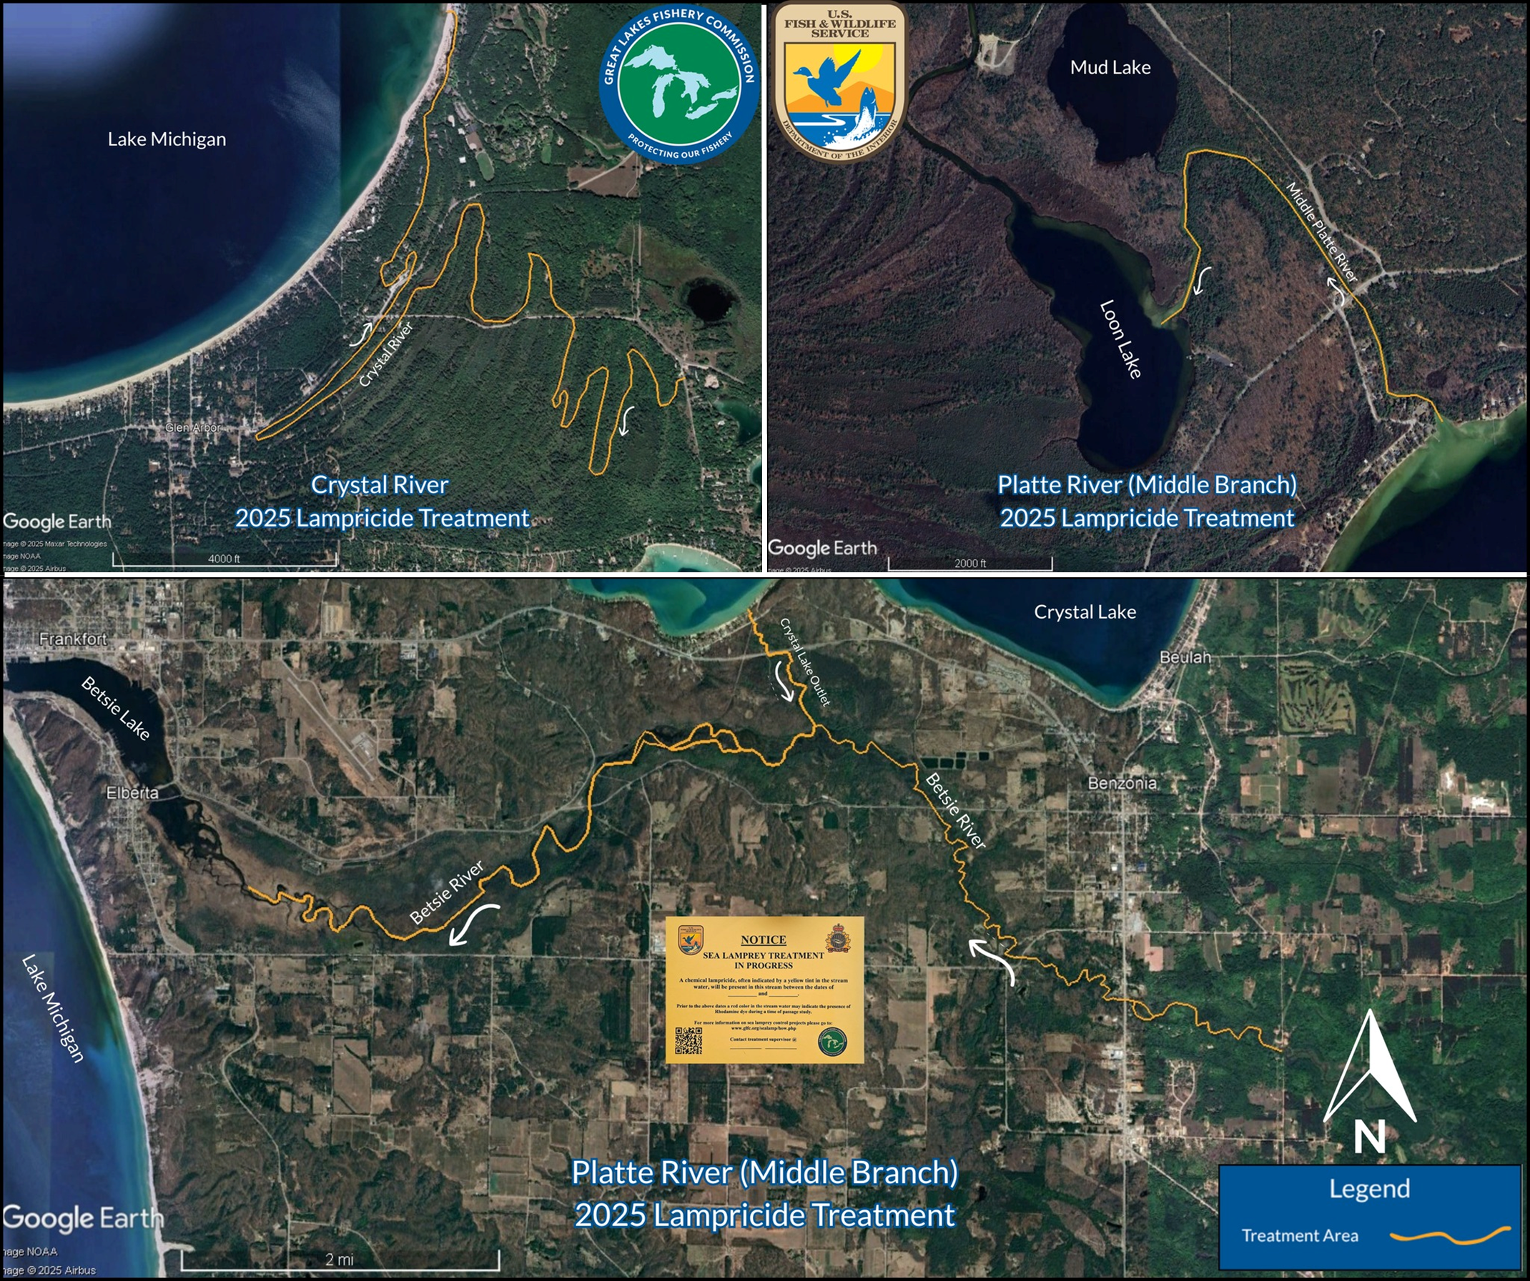
Communication tool
Equips fisheries managers and partners
Helps to address lampricide treatment questions

Slide 10
QUESTIONS?

